Slide 1
Formic acid fuel cell catalyst
Marcus Nørgaard Weng, Nanoscience MSc student, CHEAC, Jan Rossmeisl group

Slide 2
Table of contents
Power-to-X
Formic acid (Compared to hydrogen)
Reaction pathways
DFT data (new)
Activity estimation

Slide 3






Power-to-X
Energy sources
Non-renewable:
Renewable:
Oil
Solar
Coal
Wind
Nuclear
Hydro
Notes:
Example: Hornsdale Power Reserve

Slide 4
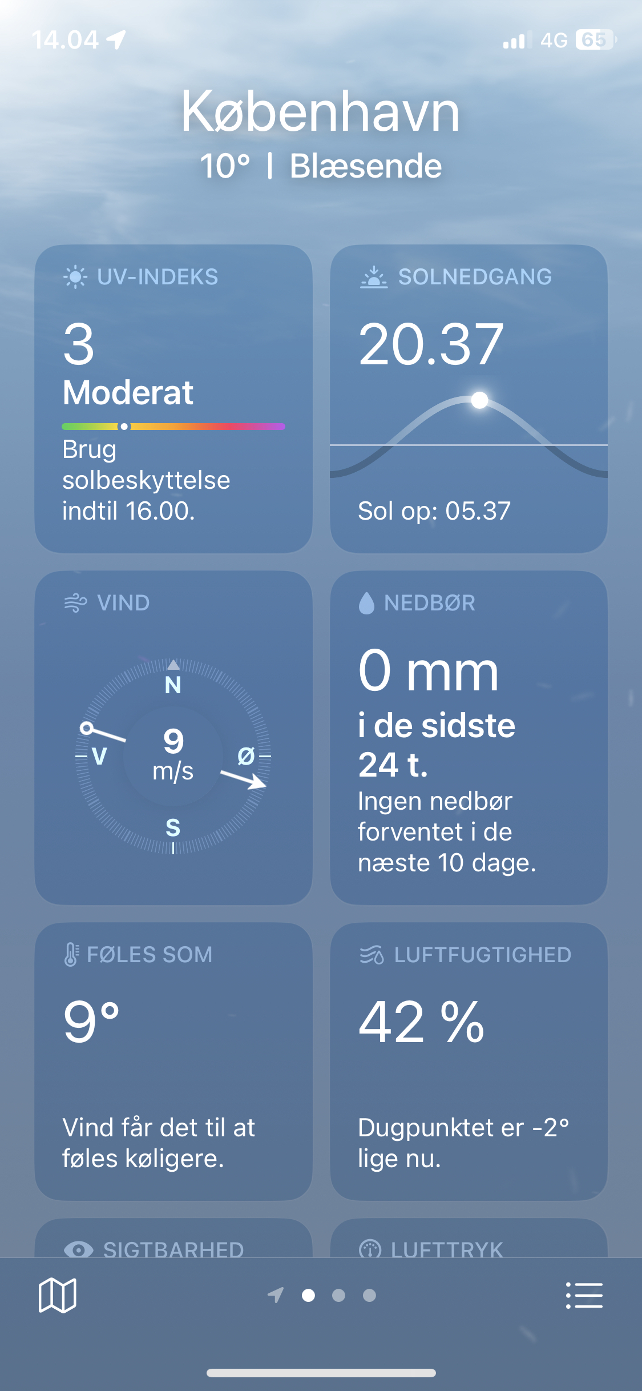
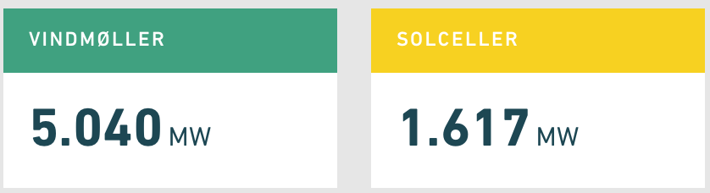
Power-to-X
Energy sources
Non-renewable:
Renewable:
Varying supply based on weather
Oil
Solar
Coal
Wind
Nuclear
Hydro
Notes:
Example: Hornsdale Power Reserve

Slide 5





Power-to-X
Energy sources
Storage options
Non-renewable:
Renewable:
Batteries
Excess electrical energy
+ Stores electrical energy
- Expensive
- Limited storage capacity
- Requires rare earth materials
Oil
Solar
Coal
Wind
Power-to-X
+ Stores energy as fuel
+ Fuel usable in some combustion motors
+ Scalable storage capacity
- Energy loss in conversion
Nuclear
Hydro
Notes:
Example: Hornsdale Power Reserve

Slide 6
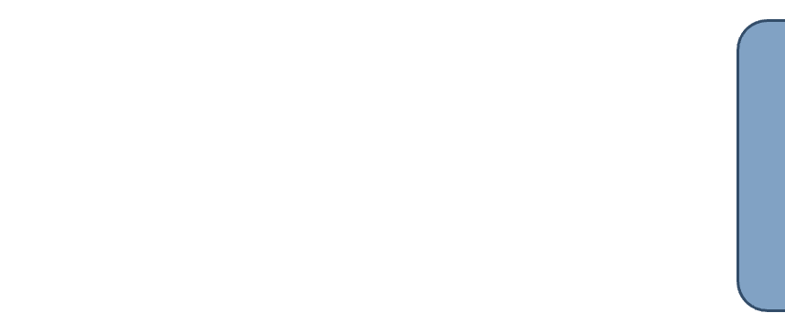

Power-to-X
Power-to-X
Power
Conversion
Fuel
Notes:
Check the numbers

Slide 7

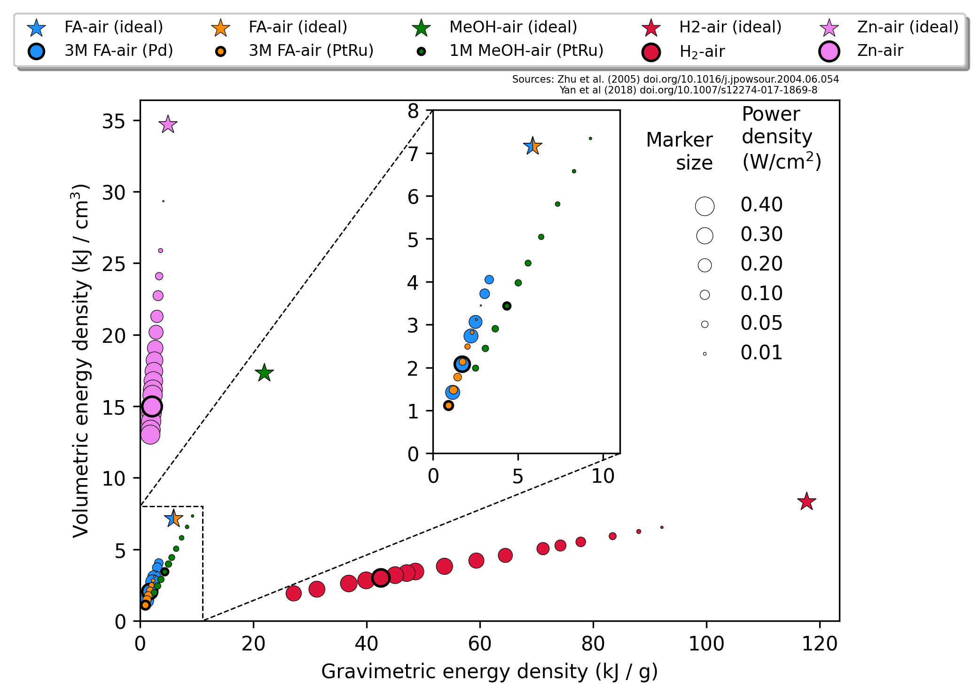
Power-to-X
Power-to-X
Power
Conversion
Fuel
Fuel cell
Power
Fuel types
Gas
Liquid
Hydrogen (H₂)
7 kJ/cm³ (ideal)
120 kJ/g (ideal)
Methanol (MeOH)
17 kJ/cm³ (ideal)
24 kJ/g (ideal)
Formic Acid (HCOOH)
7 kJ/cm³ (ideal)
6 kJ/g (ideal)
Figure made by Jack NOT ME
Notes:
More fuels? Ammonia? Li-Ion batteries
Udregn energi-effektiviteten som motivation for at bruge FA

Slide 8
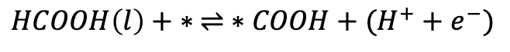
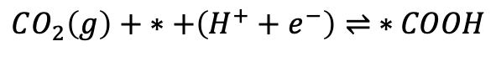
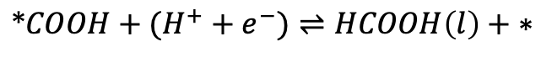
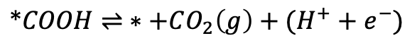
Formic Acid
$$CO_{2}\left(g\right)+ ∗+\left(H^{+}+e^{−}\right)⇌ ∗COOH$$
$$∗COOH+(H^{+}+e^{−})⇌HCOOH\left(l\right)+ ∗$$
Reduction
CO₂
HCOOH
Oxidation
$$HCOOH\left(l\right)+ ∗ ⇌ ∗COOH+(H^{+}+e^{−})$$
$$∗COOH⇌ ∗+CO_{2}\left(g\right)+(H^{+}+e^{−})$$
Notes:
Show the molecule
We want to turn it back into CO2
Also show how it’s made

Slide 9
Formic acid oxidation reactions
*CO desorbs at high potentials, ruining the surface
Figure source: Bagger, Alexander, et al. "Correlations between experiments and simulations for formic acid oxidation." Chemical Science 13.45 (2022): 13409-13417.
Notes:
Hvis man piller alle H'erne af MeOH har man CO, med FA får man CO2

Slide 10
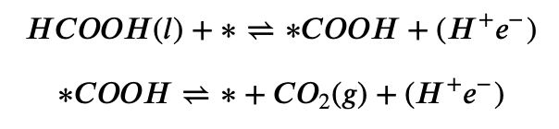
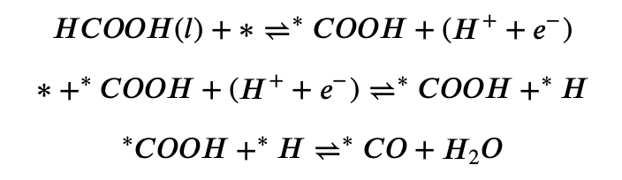
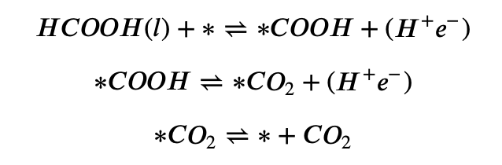
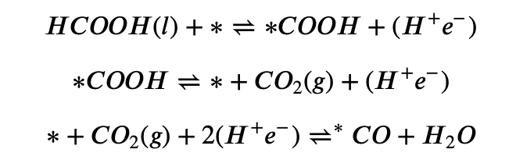
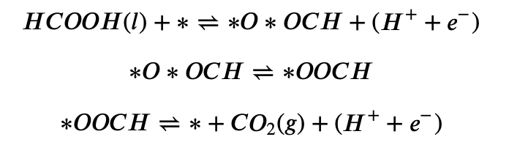
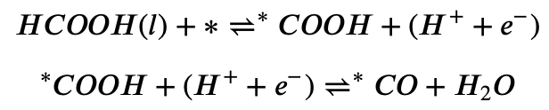
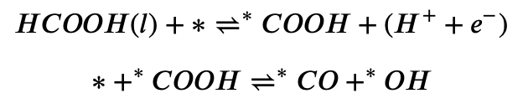
Reaction pathways
Favourable reactions:
Unfavourable reactions:

Slide 11
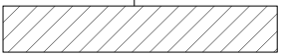
Formic acid oxidation reactions
”Standard”
”Dentates”
”H on the side”
”H from solution”
”CO-OH slide”

Slide 12
Formic acid oxidation reactions
”Standard”
”Dentates”
”H on the side”
”H from solution”
”CO-OH slide”
”CO₂RR at the end”
Notes:
Hvilket mix-forhold giver flest baderinge? Matematisk problem
To ting man kan prøve:
Lithium og Ruthenium (Evt. nyt datasæt?)
Samme analyse som for Jacks CO (Highly cited paper, 2020, HEA for CO and CO2 reduction)
Læs Alexanders artikel grundigt
Prøv med analyse der svarer til CO2/CO reduktion
Model for COOH
Model for brint
Det er vigtigt at du ikke har Hydrogenbinding i nærheden af

Slide 13
DFT data from Jack

Slide 14
Formic acid oxidation reactions
Missing data!
”Standard”
”Dentates”
”H on the side”
”H from solution”
”CO-OH slide”
”CO₂RR at the end”

Slide 15
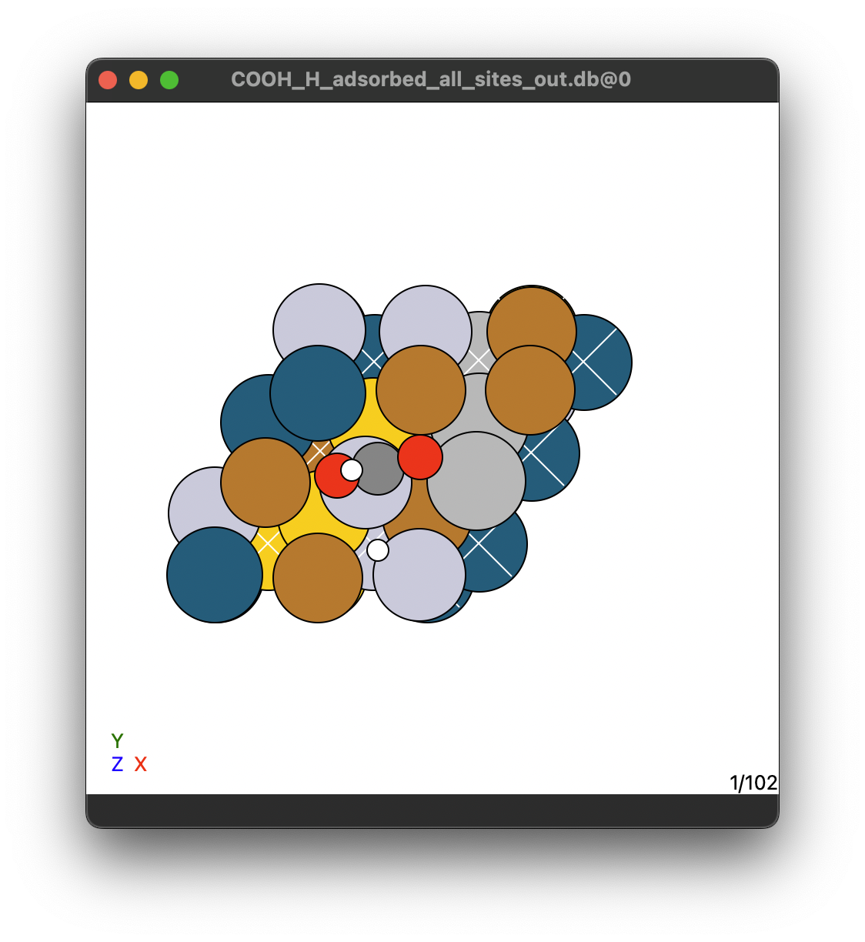
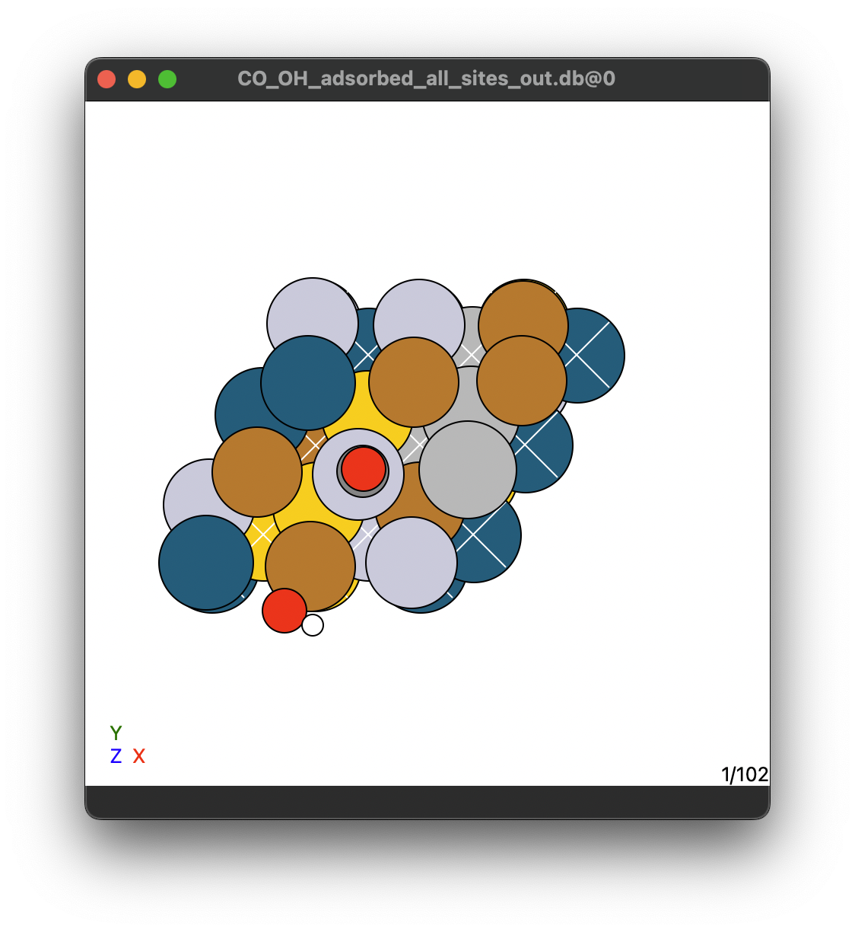
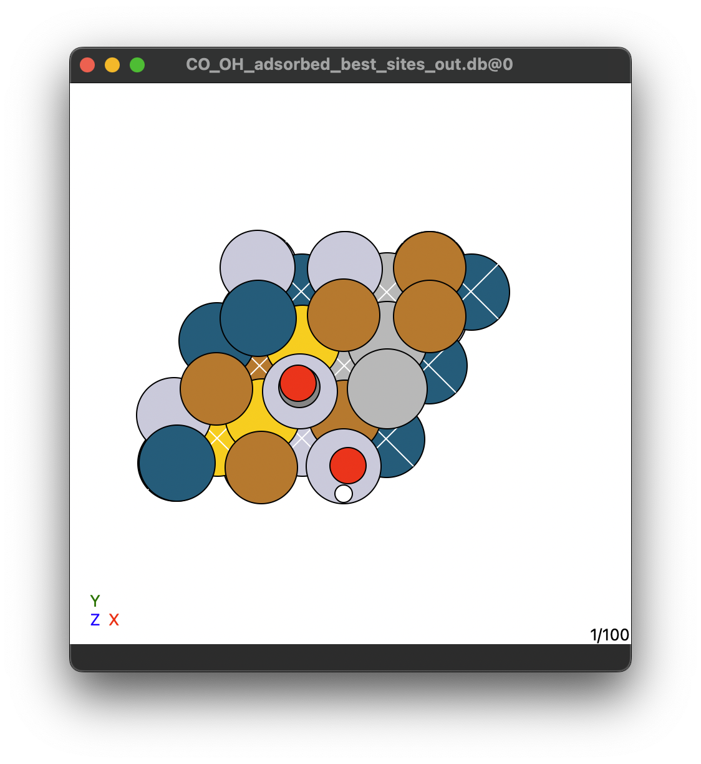
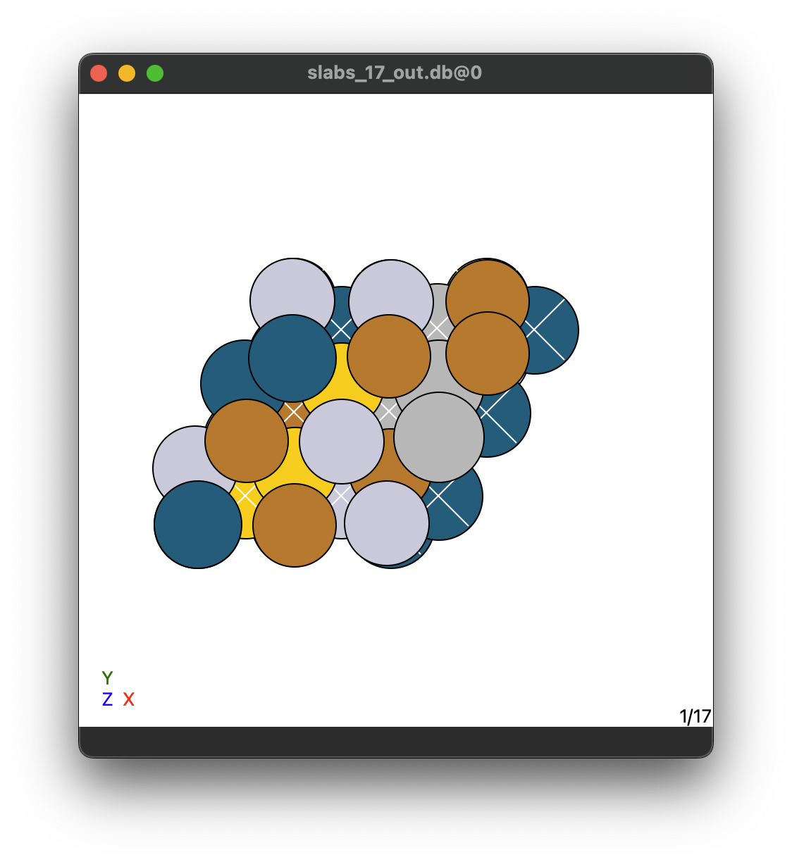
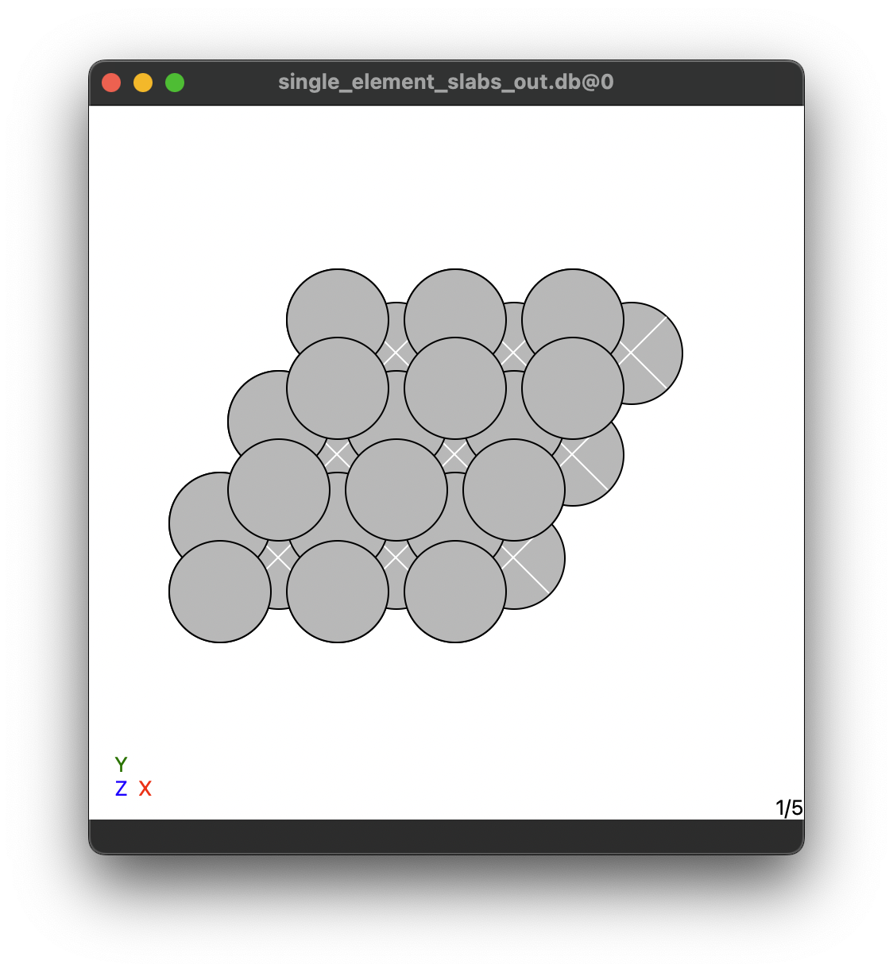
DFT calculations performed
*COOH + *H on all sites
*CO + *OH on all sites
*CO + *OH on best sites
Slabs
Slabs
Hollow-site
On-top
On-top
On-top
On-top
On-top
17 HEA slabs
6 sites/slabs
17 HEA slabs
6 sites/slabs
100 HEA slabs
1 best site/slabs
17 HEA slabs
5 pure metals
5 pure metals
5 pure metals
5 pure metals
100 HEA slabs

Slide 16
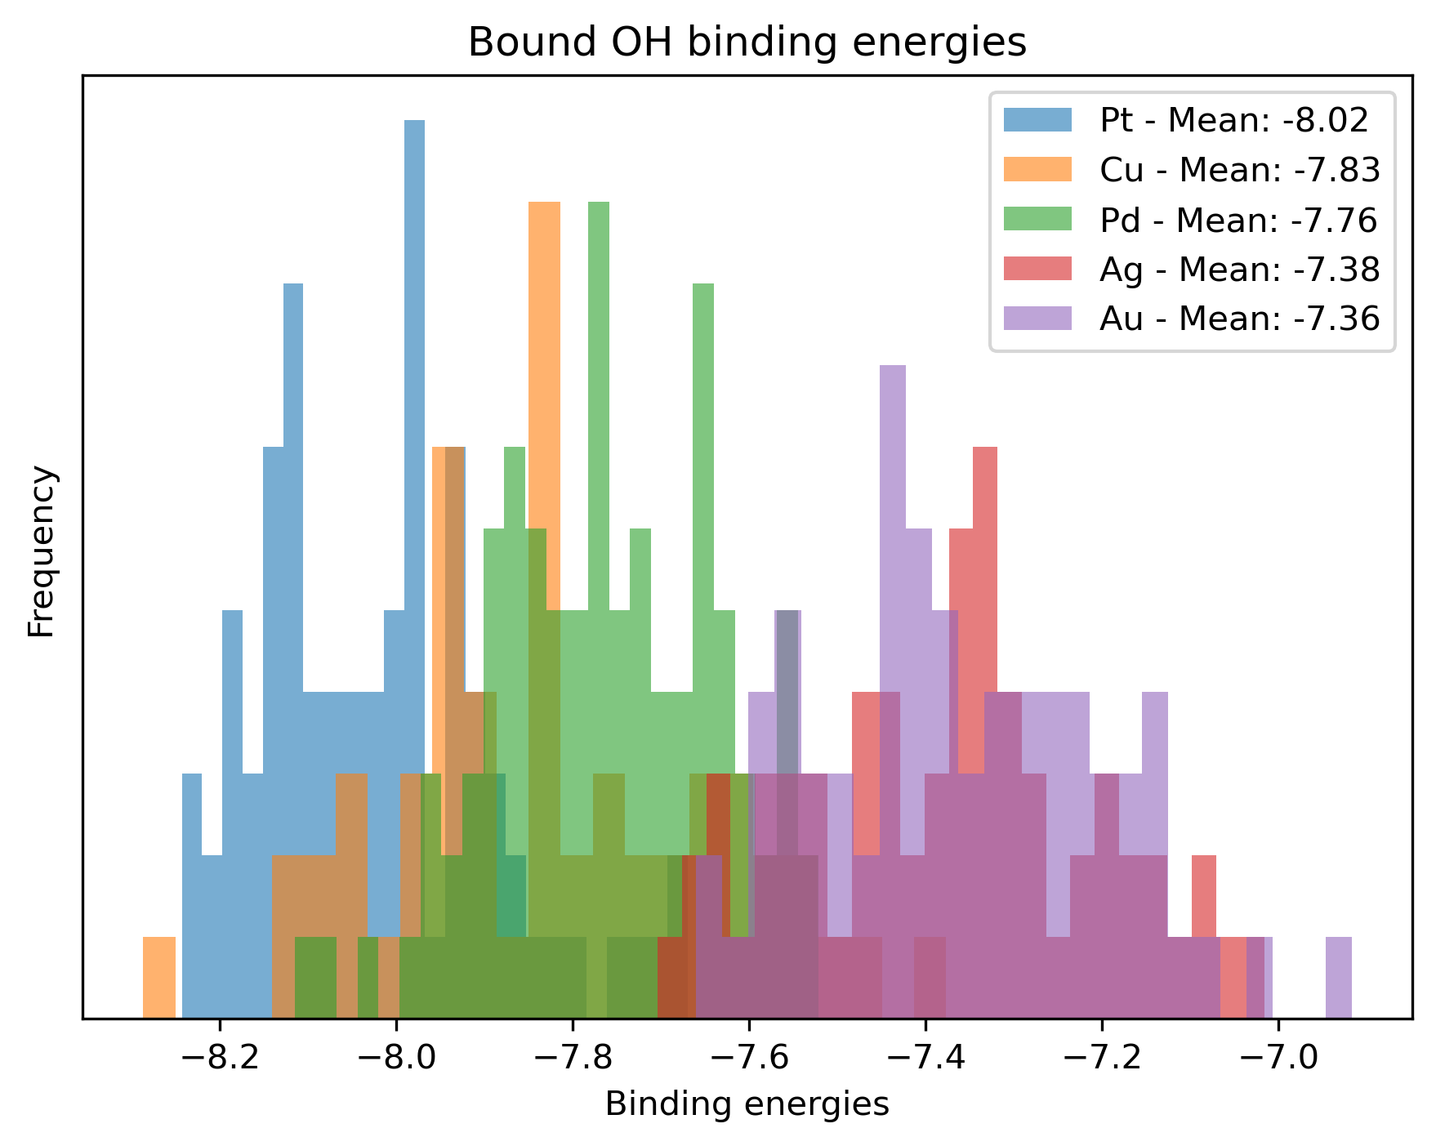
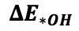
DFT calculations performed
*CO + *OH on best sites
Best binding metal in order:
On-top
On-top
Cu, Ag, Pd, Pt, Au (Rossmeisl, 2004)
100 HEA slabs
1 best site/slabs
Pt, Cu, Pd, Ag, Au (Deduced from Jacks DFT data by me)
5 pure metals
$$ΔE_{∗OH}$$

Slide 17
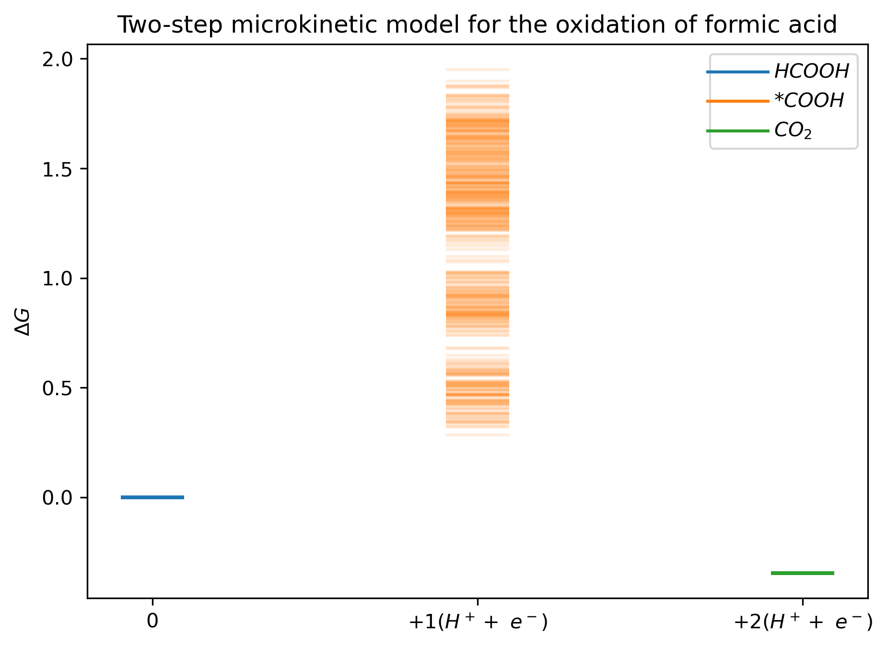
Microkinetic models
”Standard”
Notes:
Sæt

Slide 18
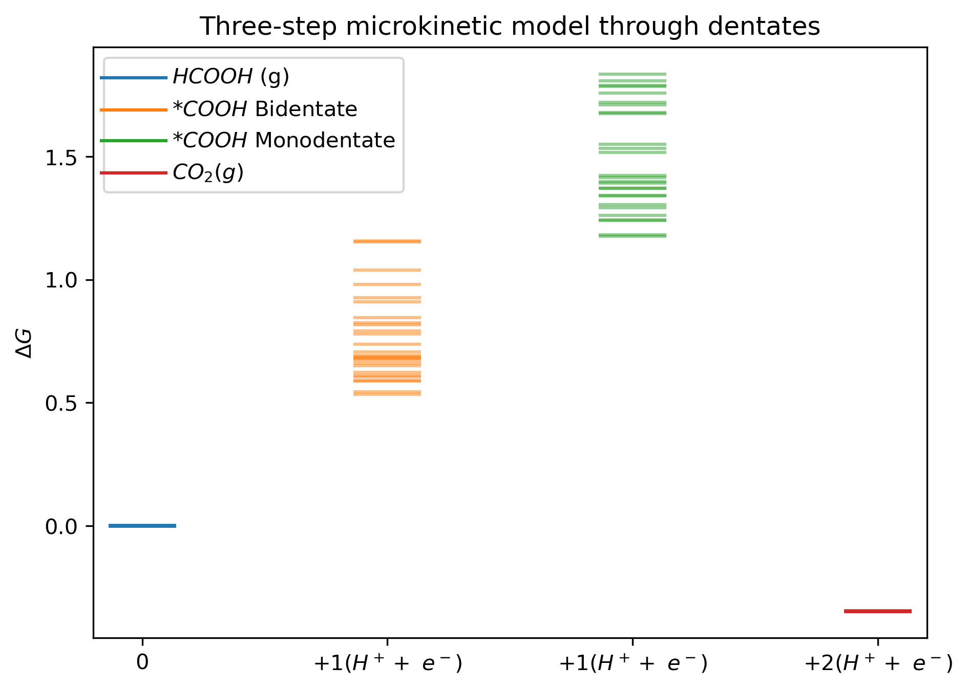
Microkinetic models
”Dentates”

Slide 19
Microkinetic models
With new DFT data

Slide 20
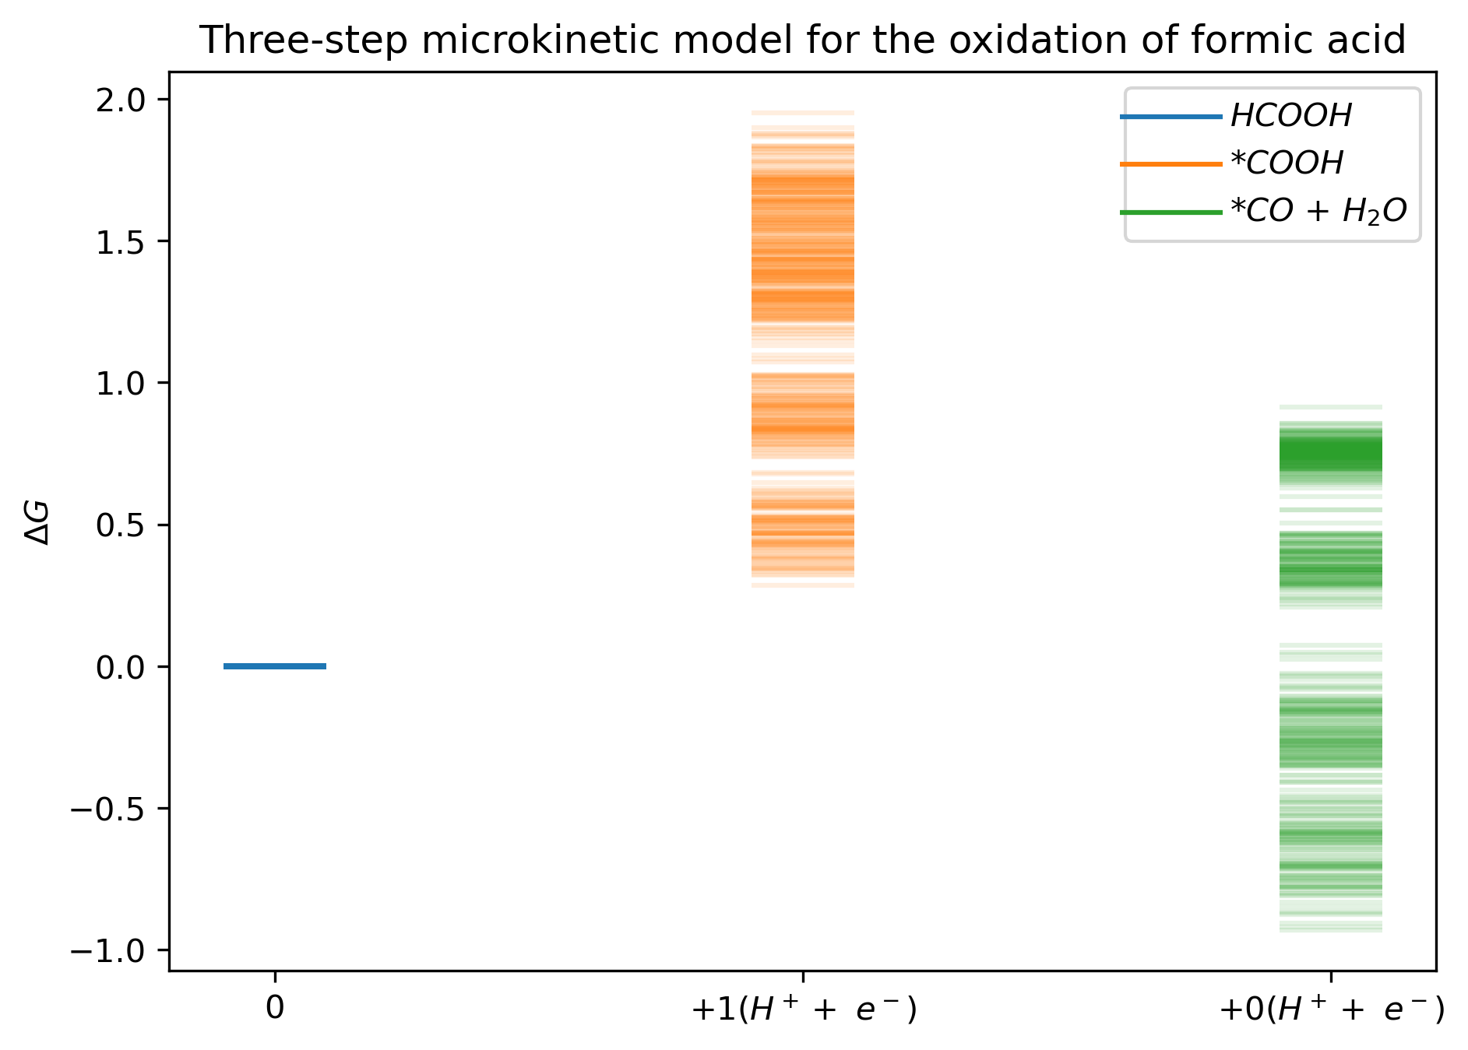
Microkinetic models
”H from solution”

Slide 21
Microkinetic models
With new DFT data
”CO-OH slide”

Slide 22
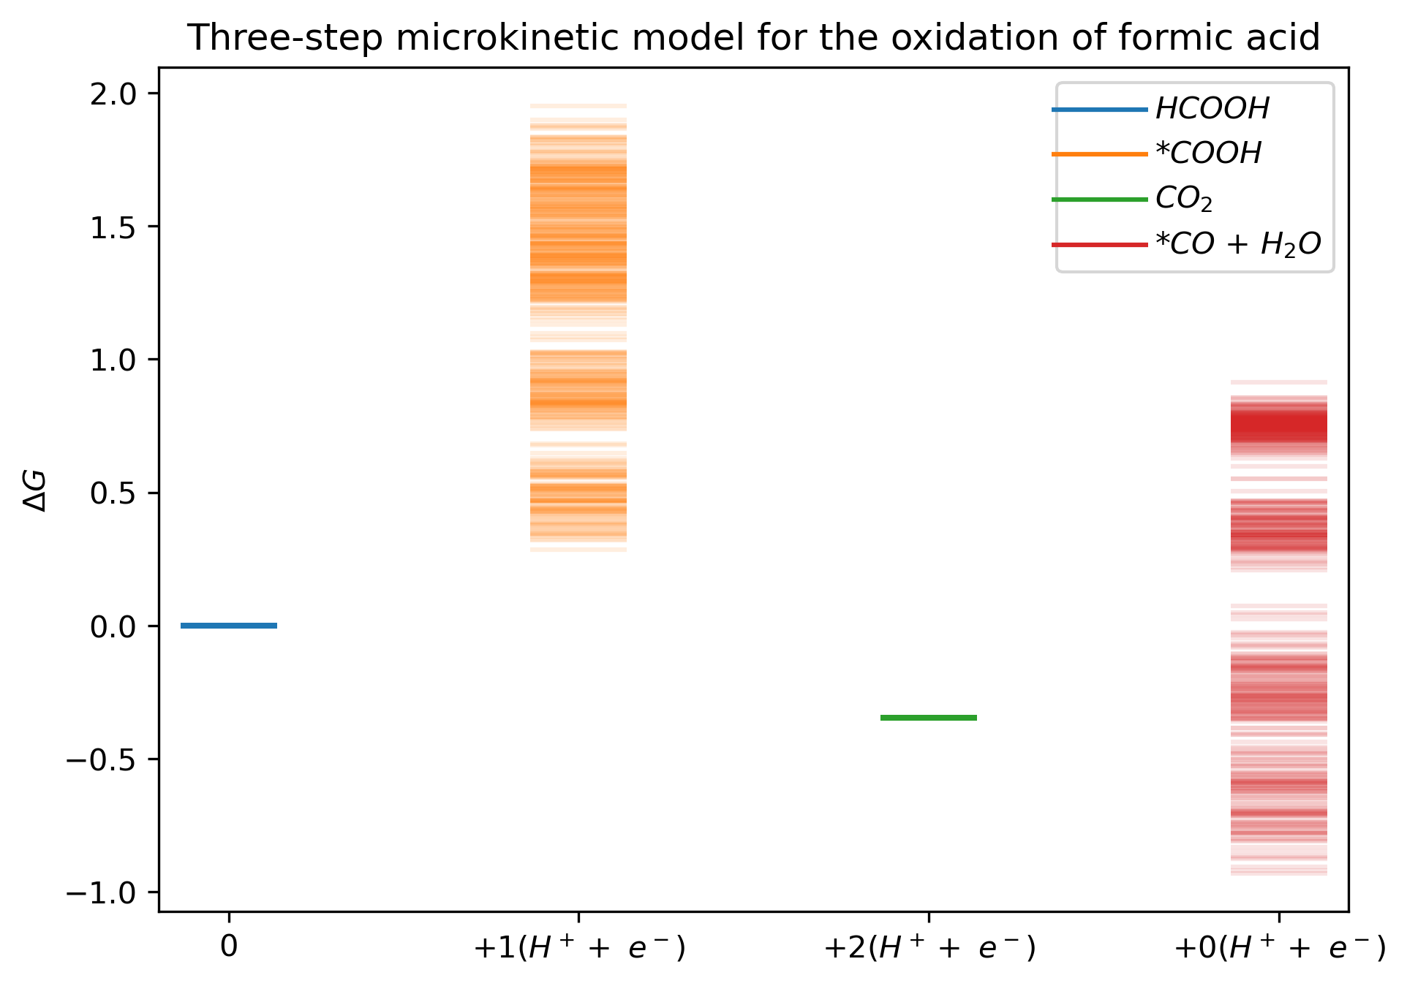
Microkinetic models
With new DFT data
”CO₂RR at the end”

Slide 23
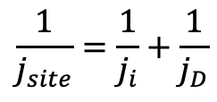
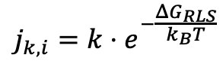
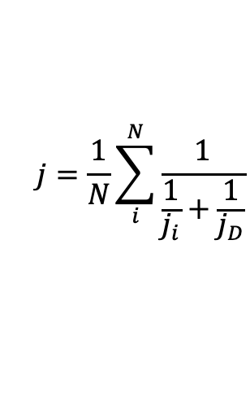
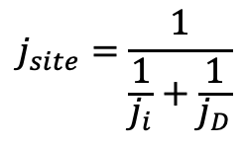
Modelling the activity of reactions
The per-site current is estimated with:
$$j_{k,i}=k⋅e^{−\frac{ΔG_{RLS}}{k_{B}T}}$$
The Koutecký-Levich equation corrects the current for mass-transport:
$$\frac{1}{j_{site}}=\frac{1}{j_{i}}+\frac{1}{j_{D}}$$
$$j_{site}=\frac{1}{\frac{1}{j_{i}}+\frac{1}{j_{D}}}$$
$$j=\frac{1}{N}\sum_{i}^{N}{\frac{1}{\frac{1}{j_{i}}+\frac{1}{j_{D}}}}$$

Slide 24
Modelling the activity of reactions
The per-site current is estimated with:
Standard two-step reaction
$$j_{k,i}=k⋅e^{−\frac{ΔG_{RLS}}{k_{B}T}}$$
The Koutecký-Levich equation corrects the current for mass-transport:
$$\frac{1}{j_{site}}=\frac{1}{j_{i}}+\frac{1}{j_{D}}$$
$$j_{site}=\frac{1}{\frac{1}{j_{i}}+\frac{1}{j_{D}}}$$
$$j=\frac{1}{N}\sum_{i}^{N}{\frac{1}{\frac{1}{j_{i}}+\frac{1}{j_{D}}}}$$

Slide 25
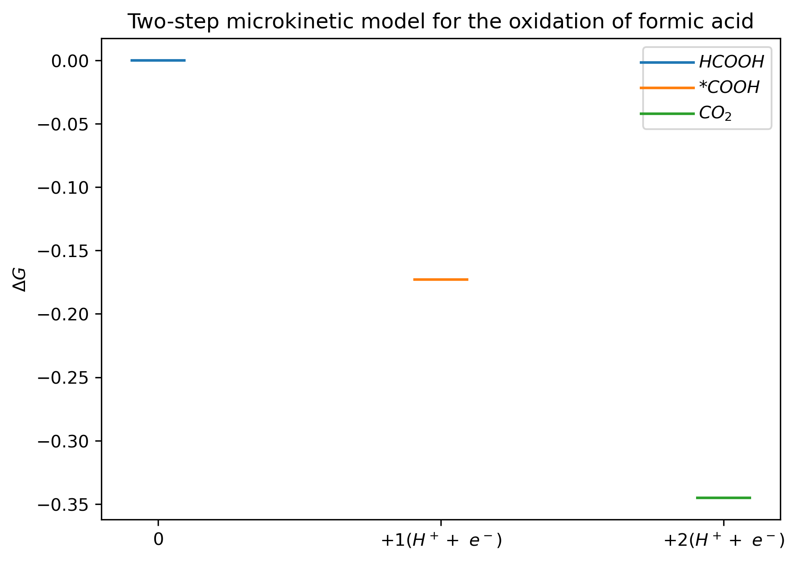
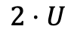
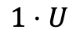
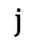
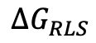
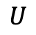
Modelling the activity of reactions
The per-site current is estimated with:
Standard two-step reaction
$$j_{k,i}=k⋅e^{−\frac{ΔG_{RLS}}{k_{B}T}}$$
The Koutecký-Levich equation corrects the current for mass-transport:
$$j_{site}=\frac{1}{\frac{1}{j_{i}}+\frac{1}{j_{D}}}$$
$$1⋅U$$
$$\frac{1}{j_{site}}=\frac{1}{j_{i}}+\frac{1}{j_{D}}$$
$$j=\frac{1}{N}\sum_{i}^{N}{\frac{1}{\frac{1}{j_{i}}+\frac{1}{j_{D}}}}$$
$$2⋅U$$
$$ΔG_{RLS}=\text{|}ΔG+0.17 eV\text{|}−0.17 eV−e⋅U$$
$$U$$
$$ΔG_{RLS}$$
$$j$$

Slide 26
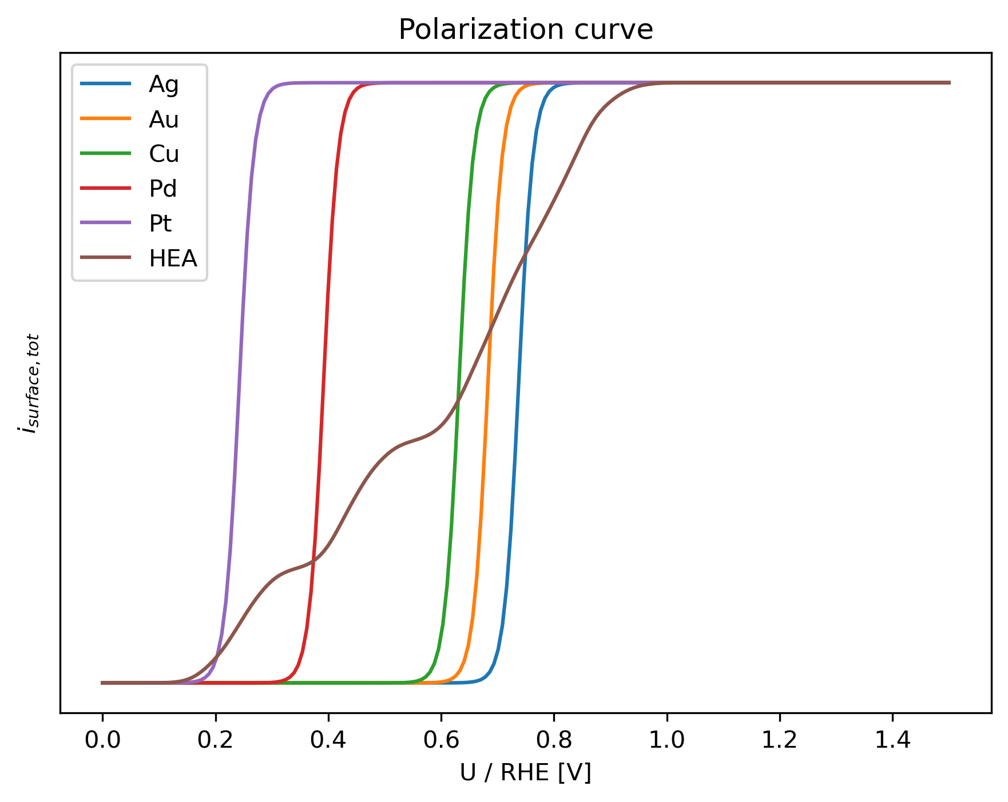
Modelling the activity of reactions
The per-site current is estimated with:
Standard two-step reaction
$$j_{k,i}=k⋅e^{−\frac{ΔG_{RLS}}{k_{B}T}}$$
The Koutecký-Levich equation corrects the current for mass-transport:
$$\frac{1}{j_{site}}=\frac{1}{j_{i}}+\frac{1}{j_{D}}$$
$$j_{site}=\frac{1}{\frac{1}{j_{i}}+\frac{1}{j_{D}}}$$
$$j=\frac{1}{N}\sum_{i}^{N}{\frac{1}{\frac{1}{j_{i}}+\frac{1}{j_{D}}}}$$
$$ΔG_{RLS}=\text{|}ΔG+0.17 eV\text{|}−0.17 eV−e⋅U$$
$$U$$
$$ΔG_{RLS}$$
$$j$$

Slide 27
Show reaction diagrams for the ones I had data on initially

Slide 28
Show the thing about if you go too low in voltage you adsorb H, and then you have to go really high to remove the CO that forms. But if you don’t go all the way down, then you have shite efficiency, so solving the H + COOH problem is neccessary

Slide 29
Searching for a composition, that has as few *H and *COOH pairs
Goal:
Find a composition, that has as few *H and *COOH pairs as possible
Results in *CO
Notes:
Hvor godt C og H bliver bundet scalerer vist rimeligt tæt (Alexanders artikel siger noget om det), men kan man ikke bare sætte A til at være noget der binder godt for COOH, og så have B være et atom, som ikke binder noget som helst adsorbat godt. Hvis man så har baderinge, så vil kun enten H eller COOH sætte sig i baderingene, så får man ikke –H og –COOH ved siden af hinanden, fordi man ikke får noget som helst ved siden af hinanden

Slide 30
Searching for a composition, that has as few *H and *COOH pairs
Making a surface with swim ring structures, that discourages H from adsorbing next to COOH
B
B
B
A
B
B
B
Swim ring structure
Results in *CO

Slide 31
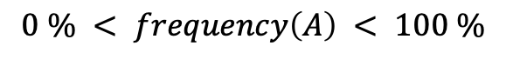
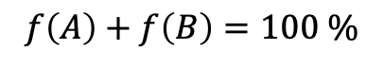
Searching for a composition, that has as few *H and *COOH pairs
Which ratio of atom A and atom B distributed randomly in a 2D hexagonal close packed surface results in the largest occurrence of swim rings?
$$0 \% < frequency\left(A\right) < 100 \%$$
$$f\left(A\right)+f\left(B\right)=100 \%$$
A higher f(A) gives more possibilities for swim rings, but also a higher risk of ruining the swim ring with another A. Therefore, there must be a maximum f(swim rings) somewhere in the middle.
B
B
B
A
B
Assumption: Two neighbouring A’s are worthless, just like B sites
B
B
Swim ring structure
Results in *CO

Slide 32
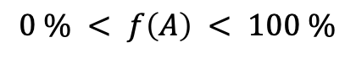
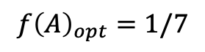
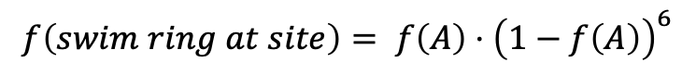
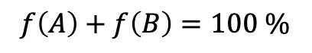
Searching for a composition, that has as few *H and *COOH pairs
$$0 \% < f\left(A\right) < 100 \%$$
$$f\left(A\right)+f\left(B\right)=100 \%$$
Postulate: The odds of finding a swim ring on/around a site is equivalent to the odds of the site being atom A AND that there is no A in the 6 surrounding atoms
$$f\left(swim ring at site\right)= f\left(A\right)⋅{\left(1−f\left(A\right)\right)}^{6}$$
What is the maximum of that function when varying f(a)?
B
B
$$f’\left(swim ring at site\right)= {\left(1−f{\left(A\right)}_{opt}\right)}^{6}−6⋅f{\left(A\right)}_{opt}⋅{\left(1−f{\left(A\right)}_{opt}\right)}^{5}=0$$
B
A
B
B
B
$$f{\left(A\right)}_{opt}=1/7$$
Swim ring structure
Results in *CO

Slide 33
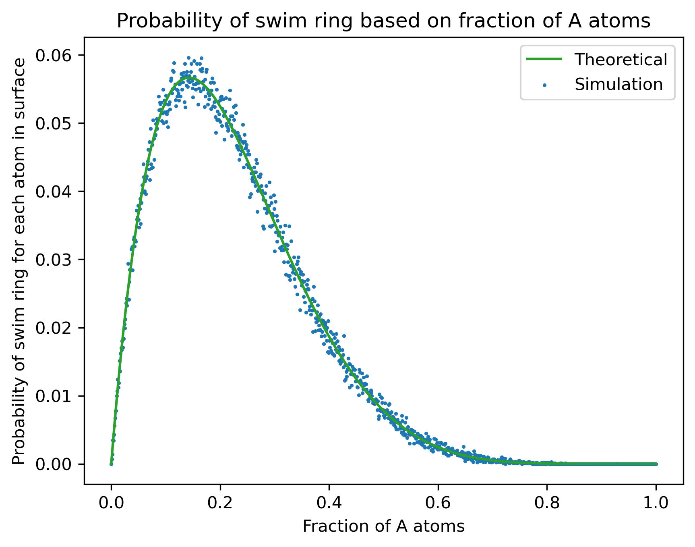
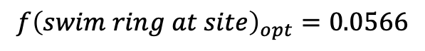
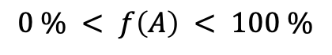
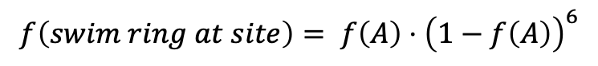
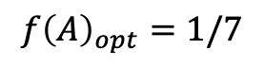
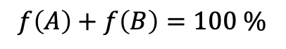
Searching for a composition, that has as few *H and *COOH pairs
$$f\left(swim ring at site\right)= f\left(A\right)⋅{\left(1−f\left(A\right)\right)}^{6}$$
$$0 \% < f\left(A\right) < 100 \%$$
$$f\left(A\right)+f\left(B\right)=100 \%$$
$$f{\left(swim ring at site\right)}_{opt}=0.0566$$
B
B
B
A
B
B
B
$$f{\left(A\right)}_{opt}=1/7$$
Swim ring structure

Slide 34

Searching for a composition, that has as few *H and *COOH pairs
B
B
B
A
B
B
B
Swim ring structure

Slide 35

Searching for a composition, that has as few *H and *COOH pairs
B
B
B
A
B
B
B
Swim ring structure

Slide 36


Searching for a composition, that has as few *H and *COOH pairs
B
B
B
A
B
B
B
Swim ring structure

Slide 37
Binding energy prediction models for -H and -COOH
Models:
Hollow site –H
Input: Same vector as other hollow-site models
Output: Binding energy
On-top site –COOH
Input: Same vector as other on-top site models
Output: Binding energy
Mixed site –H and –COOH
Input: On-top vector AND hollow-site vector combined?
Output: Binding energy

Slide 38




Methods – Predicting binding energies
Label:
Energy
On-top slab
*
Input:
Regression algorithm
Feature vector
Label:
Energy
Hollow-site slab
Input:
Regression algorithm
Feature vector
*Christian M Clausen et al. “What Atomic Positions Determines Re- activity of a Surface? Long-Range, Directional Ligand Effects in Metallic Alloys”. In: Advanced Science 8.9 (2021), p. 2003357.
Notes:
SLIDE FRA PUK – ALLEREDE BRUGT TIL EKSAMEN - MÅ MAN BRUGE ET IDENTISK SLIDE?

Slide 39

Methods – Predicting binding energies
Label:
Energy
Mixed slab
Input:
Regression algorithm
Feature vector
Both vectors added together?
*Christian M Clausen et al. “What Atomic Positions Determines Re- activity of a Surface? Long-Range, Directional Ligand Effects in Metallic Alloys”. In: Advanced Science 8.9 (2021), p. 2003357.
Notes:
SLIDE FRA PUK – ALLEREDE BRUGT TIL EKSAMEN - MÅ MAN BRUGE ET IDENTISK S

Slide 40
To do

Slide 41
Further work (or just completing my thesis)
Energy prediction models for each substance
Activity measurement for each reaction step
Competing activities – Single score? Good vs bad reactions
Surface composition + U -> Single good activity score?
Triangular plots showing single score?

Slide 42
Which reactions couldn’t I look at yet? Why? Hence -> new DFT data
Trying to see which ones might be important. Alexander bagger had an idea about which.
Also we’re trying to avoid CO on the surface, because it desorbs at high potentials.

Slide 43
So formic acid is pretty cool
What is the problem?
Looking at all the ways it can break down
Goal: Be able to simulate activity of all reaction pathways from a surface composition
Then search for a surface on which the bad reactions are slow and the good ones are fast

Slide 44
Reaction pathways
Figure source: Bagger, Alexander, et al. "Correlations between experiments and simulations for formic acid oxidation." Chemical Science 13.45 (2022): 13409-13417.

Slide 45
Reaction pathways
Favourable reactions:
Unfavourable reactions:

Slide 46
H
O
H
O
-
=
-
=
O
-
C
O
-
-
C
H
-
H
H
O
-
=
O
C

Slide 47



DFT data
*CO *OH best sites
*CO *OH all sites
100 HEA slabs
17 HEA slabs
5 pure metals
1 best site/slabs
6 sites/slabs
I accidentally put all 5 in there twice
100 total
102 total

Slide 48


DFT data
COOH and H on all sites
17 HEA slabs
5 pure metals
6 sites/slab
102 total

Slide 49



DFT data - slabs
Slabs for

Slide 50

DFT calculations performed
Slabs
*CO *OH best sites
*CO *OH all sites
*COOH *H all sites
17 HEA slabs
On-top
On-top
On-top
On-top
Hollow-site
On-top
100 HEA slabs
17 HEA slabs
17 HEA slabs
1 best site/slabs
6 sites/slabs
6 sites/slabs
100 total
102 total
102 total
Slabs
100 HEA slabs

Slide 51
DFT calculations performed – Neighbour interactions
*COOH + *H on all sites
*CO + *OH on all sites
*CO + *OH on best sites
Slabs
Slabs
Hollow-site
On-top
On-top
On-top
On-top
On-top
17 HEA slabs
6 sites/slabs
17 HEA slabs
6 sites/slabs
100 HEA slabs
1 best site/slabs
17 HEA slabs
5 pure metals
5 pure metals
5 pure metals
5 pure metals
100 HEA slabs

Slide 52




DFT calculations performed – Swim rings
*H
*COOH
*H + *COOH
B
B
Slabs
B
A
B
Hollow-site
On-top
Hollow-site
On-top
20 slabs/combination
120 total
20 slabs/combination
120 total
20 slabs/combination
120 total
20 slabs/combination
120 total
B
B
Swim ring structure
A: Pt, Pd
B: Ag, Au
Combinations:
PtAu, PtAg, PtAuAg, PdAu, PdAg, PdAuAg

Slide 53




Storage of extra stuff from the slideshow

Slide 54


Reaction pathways
Favourable reactions:
H
O
-
=
O
-
C
-
H
H
O
$$− \left(H^{+}+e^{−}\right)$$
-
=
O
-
C
-
O
O
$$− \left(H^{+}+e^{−}\right)$$
=
=
C

Slide 55


Reaction pathways
Favourable reactions:
H
O
-
=
O
-
C
-
H
H
$$− \left(H^{+}+e^{−}\right)$$
-
C
-
-
O
O
-
-
-
O
=
$$− \left(H^{+}+e^{−}\right)$$
C
=
O

